Slide 1
COMPUTER ORGANISATION
CENTRAL PROCESSING UNIT

Slide 2
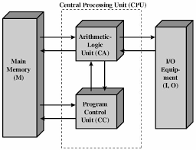
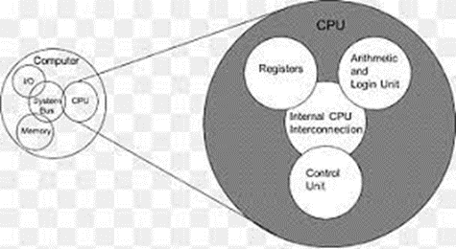
What Is Central Processing Unit?
A Central Processing Unit is also called a processor, central processor, or microprocessor. It carries out all the important functions of a computer. It receives instructions from both the hardware and active software and produces output accordingly. It stores all important programs like operating systems and application software. CPU also helps Input and output devices to communicate with each other. Owing to these features of CPU, it is often referred to as the brain of the computer.

Slide 3
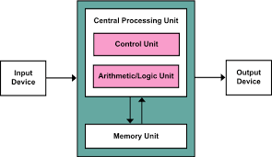
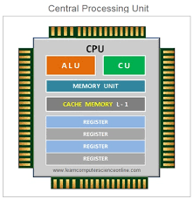

Central Processing Unit

Slide 4

Components Of CPU
ALU (Arithmetic Logic Unit): It is the arithmetic logic unit, which performs arithmetic and logical functions. Arithmetic functions include addition, subtraction, multiplication division, and comparisons. Logical functions mainly include selecting, comparing, and merging the data. A CPU may contain more than one ALU. Furthermore, ALUs can be used for maintaining timers that help run the computer.

Slide 5
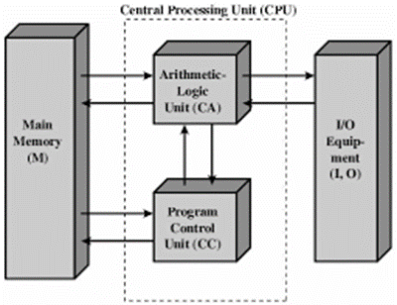

Control Unit: It is the circuitry in the control unit, which makes use of electrical signals to instruct the computer system for executing already stored instructions. It takes instructions from memory and then decodes and executes these instructions. So, it controls and coordinates the functioning of all parts of the computer. The Control Unit's main task is to maintain and regulate the flow of information across the processor. It does not take part in processing and storing data.

Slide 6
Memory or Storage Unit: It is called Random access memory (RAM). It temporarily stores data, programs, and intermediate and final results of processing. So, it acts as a temporary storage area that holds the data temporarily, which is used to run the computer.

Slide 7
Types Of CPU
CPUs are mostly manufactured by Intel and AMD, each of which manufactures its own types of CPUs. In modern times, there are lots of CPU types in the market. Some of the basic types of CPUs are described below:
1. Single Core CPU: Single Core is the oldest type of computer CPU, which was used in the 1970s. It has only one core to process different operations. It can start only one operation at a time; the CPU switches back and forth between different sets of data streams when more than one program runs. So, it is not suitable for multitasking as the performance will be reduced if more than one application runs. The performance of these CPUs is mainly dependent on the clock speed. It is still used in various devices, such as smartphones.

Slide 8
2. Dual Core CPU: As the name suggests, Dual Core CPU contains two cores in a single Integrated Circuit (IC). Although each core has its own controller and cache, they are linked together to work as a single unit and thus can perform faster than the single-core processors and can handle multitasking more efficiently than Single Core processors.

Slide 9
3. Quad Core CPU: This type of CPU comes with two dual-core processors in one integrated circuit (IC) or chip. So, a quad-core processor is a chip that contains four independent units called cores. These cores read and execute instructions of CPU. The cores can run multiple instructions simultaneously, thereby increases the overall speed for programs that are compatible with parallel processing.

Slide 10


